Slide 1
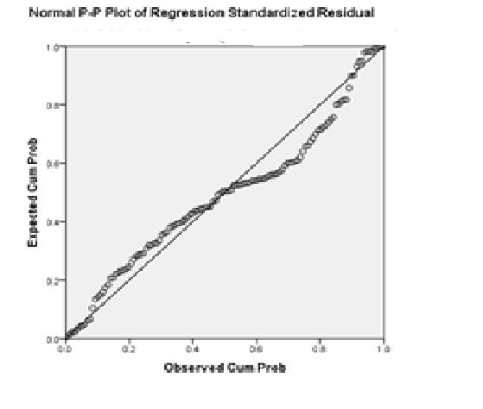
HH
Subjective Happiness Vs Freq of social gathering
Freq of Social Gathering
Subjective Happiness

